Slide 1

HS3052 Capstone Project Design: Supplementary Document
Supervisor: Dr. Farshid Keivanian
Session 1: Getting Started: Teams, Topics, Tools & Your Capstone Journey

Slide 2
Session 1’s Outline
Welcome
Tips for Finding a Group Member
Weekly Task Breakdown & Milestones
Topic Selection
Literature Review General Tips
Tools & Technologies to Use
Tips for the Implementation Phase
Skills You Will Build by Topic
Career Outlook (Australia & Global)
Platform Navigation Reminders
Preparation for Group Assignment 1 – Project Management
Group Assignments – Due Dates
HTML/CSS/Java Script/PHP Examples

Slide 3
Welcome
Welcome to Your Capstone Journey!
This guide provides a week-by-week roadmap to help undergraduate students complete HS3052 effectively. It includes tools to use, literature review guidance, project planning tips, and skills you’ll build – tailored to both the Sydney campus and online students.

Slide 4
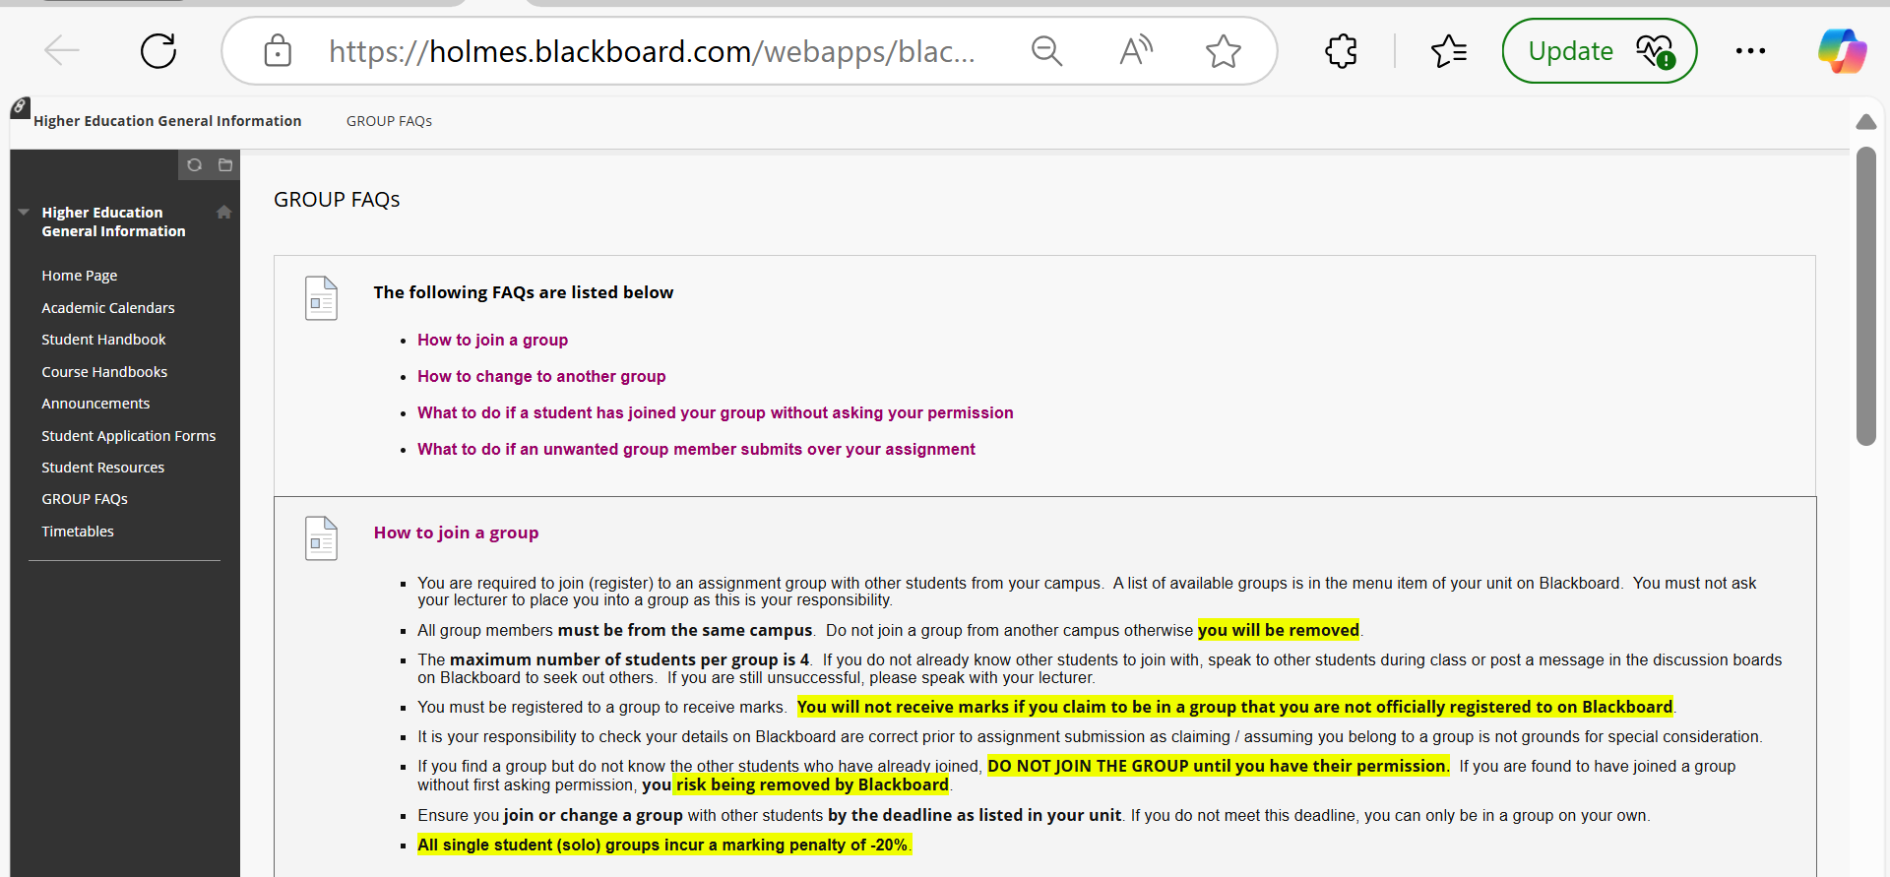
Tips for Finding a Group Member

Slide 5
Tips for Finding a Group Member
Ask During Class Time:
Approach classmates before or after lectures/tutorials.
Politely ask if they’ve joined a group or are looking for teammates.
Use Blackboard Discussion Boards:
Post a message saying you’re looking for group members.
Include your unit code, campus, and your availability.

Slide 6
Tips for Finding a Group Member
Check Campus-Based Group Lists:
Only join groups from your own campus. Blackboard will remove you if you join a cross-campus group.
Communicate First – Don’t Auto-Join:
Never join a group without asking the current members. It’s a violation of Blackboard policy and may lead to removal.

Slide 7
Tips for Finding a Group Member
Form Early – Don’t Wait Until the Deadline:
Group registrations are time-limited. Solo groups get -20% penalty, so don’t delay.
Use WhatsApp or Messenger Group Chats (if available):
Ask your classmates or tutor if there’s an unofficial chat group for the unit.
It’s a great way to coordinate and form groups quickly.

Slide 8
Tips for Finding a Group Member
Let Your Strengths Be Known:
Mention what you’re good at (e.g., writing, research, analysis, presentation) to show how you can contribute.
Be Respectful and Professional:
If a group is full or someone declines, thank them and keep looking.
Respect group size limits (max 4 students).

Slide 9
Tips for Finding a Group Member
If you're still unable to join a group after trying all the steps, you may email coordinator/me or Blackboard Helpdesk for further assistance – but only after trying all self-enrollment options.

Slide 10
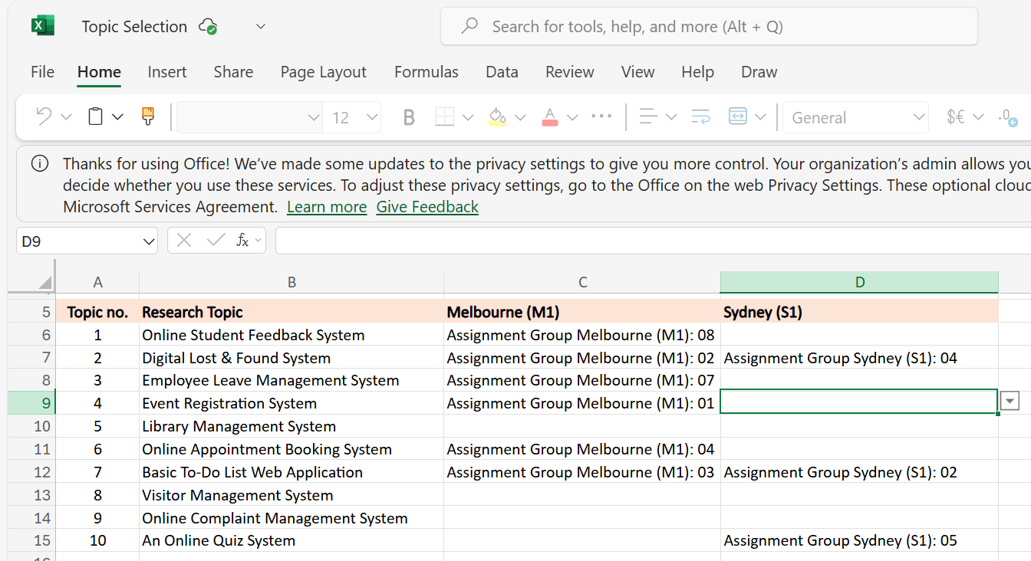
Topic Selection Instructions
Sydney Students
Add your Group Number next to your selected topic on the shared Excel sheet.
This locks the topic for your group before others take it.
Each topic can only be selected by one group per campus.
How to Access the Topic Selection Sheet: Blackboard ➝ Assessments ➝ Projects ➝ Topic Selection Link

Slide 11
Weekly Task Breakdown & Milestones
Week | Tasks | Notes
1 | Finalise group & select topic | Choose from topics like Library Mgmt, Lost & Found, Feedback System, etc.
2 | Project Management Package (Assessment 1 due) | Scope, charter, WBS, Gantt chart – submit as a group
3–4 | Requirements analysis + Literature review | Collect references, interview users, gather data, start drafting RS
5 | Presentation of proposed solution (Assessment 2) | Slides + demo/mockup preview
6 | Submit Requirements Specification (Assessment 3) | System overview, diagrams, user stories, use cases, ERD, schema
7 | Prototype building begins | Setup tools, split coding and UI/UX tasks among group

Slide 12
Weekly Task Breakdown & Milestones
Week | Tasks | Notes
8–11 | Development + testing | Complete features, peer review, fix bugs, update documents
12 | Submit Final Prototype + Docs (Assessment 4) | Include testing report, user manual, installation guide, project closure plan

Slide 13
Literature Review General Tips
Use at least 5–8 scholarly sources from the last 5–7 years.
Focus on gaps or limitations in existing systems.
Identify what's missing in current solutions (e.g., security flaws, poor UX, outdated tech).
Use Google Scholar, ACM Digital Library, IEEE Xplore, and ProQuest via Holmes Library.

Slide 14
Literature Review General Tips
Key sections to include:
Introduction to your domain (e.g., Feedback Systems)
Comparative table of 3–5 existing systems
Analysis of best practices, strengths, and weaknesses
Identified gaps and justification for your proposed system

Slide 15
Tools & Technologies to Use
Category | Suggested Tools
Web Development | HTML, CSS, JavaScript, PHP, Bootstrap, XAMPP, Node.js, MySQL
Mobile Development | Flutter, Dart, Android Studio, Firebase, SQLite
IDE/Code Editors | VS Code, IntelliJ IDEA 2024.3.4.1, Eclipse, NetBeans
Analytics/Dashboards | Power BI, Google Data Studio, SAP Analytics Cloud
Documentation | MS Word, Google Docs, Draw.io, Lucidchart
Testing & Prototyping | Postman, Swagger, Figma, Balsamiq, JUnit, Selenium
Collaboration | Trello, GitHub, Google Drive, Slack

Slide 16
Tips for the Implementation Phase
Set version control early (use GitHub)
Create milestones in Trello or ClickUp
Follow Agile practices – 2-week sprints with internal demos
Assign clear roles (UI lead, backend lead, tester, doc lead)
Back up frequently on cloud drives (Google Drive/Dropbox)

Slide 17
Skills You Will Build by Topic
Topic | Skills Developed
Lost & Found System | CRUD operations, search/filtering, data validation
Feedback System | Survey design, sentiment analysis, form validation
Library Mgmt System | Inventory tracking, login/auth, user roles
Online Quiz System | Randomised questions, scoring, timers, result export
Appointment Booking | Scheduling logic, calendar integration, email triggers
Complaint Mgmt System | Workflow tracking, role-based access, escalation process

Slide 18
Career Outlook (Australia & Global)
Area | Career Roles | Demand in Australia
Web Development | Full-stack Developer, Frontend Developer | Strong – Startups, SMBs, Gov Projects
Mobile App Development | App Developer, Flutter Developer | Growing – Especially in health/retail
Data Analytics Integration | BI Analyst, Reporting Developer | High – finance, gov, real estate
System Administration | Network Admin, IT Support | Ongoing demand across sectors
Software Testing | QA Engineer, Test Analyst | Moderate to high

Slide 19
Platform Navigation Reminders
Use Blackboard > Projects to check detailed specs and due dates
Refer to Groups – Melbourne/Sydney to confirm your team
Join weekly drop-in sessions for feedback
Submit drafts early for formative feedback!

Slide 20
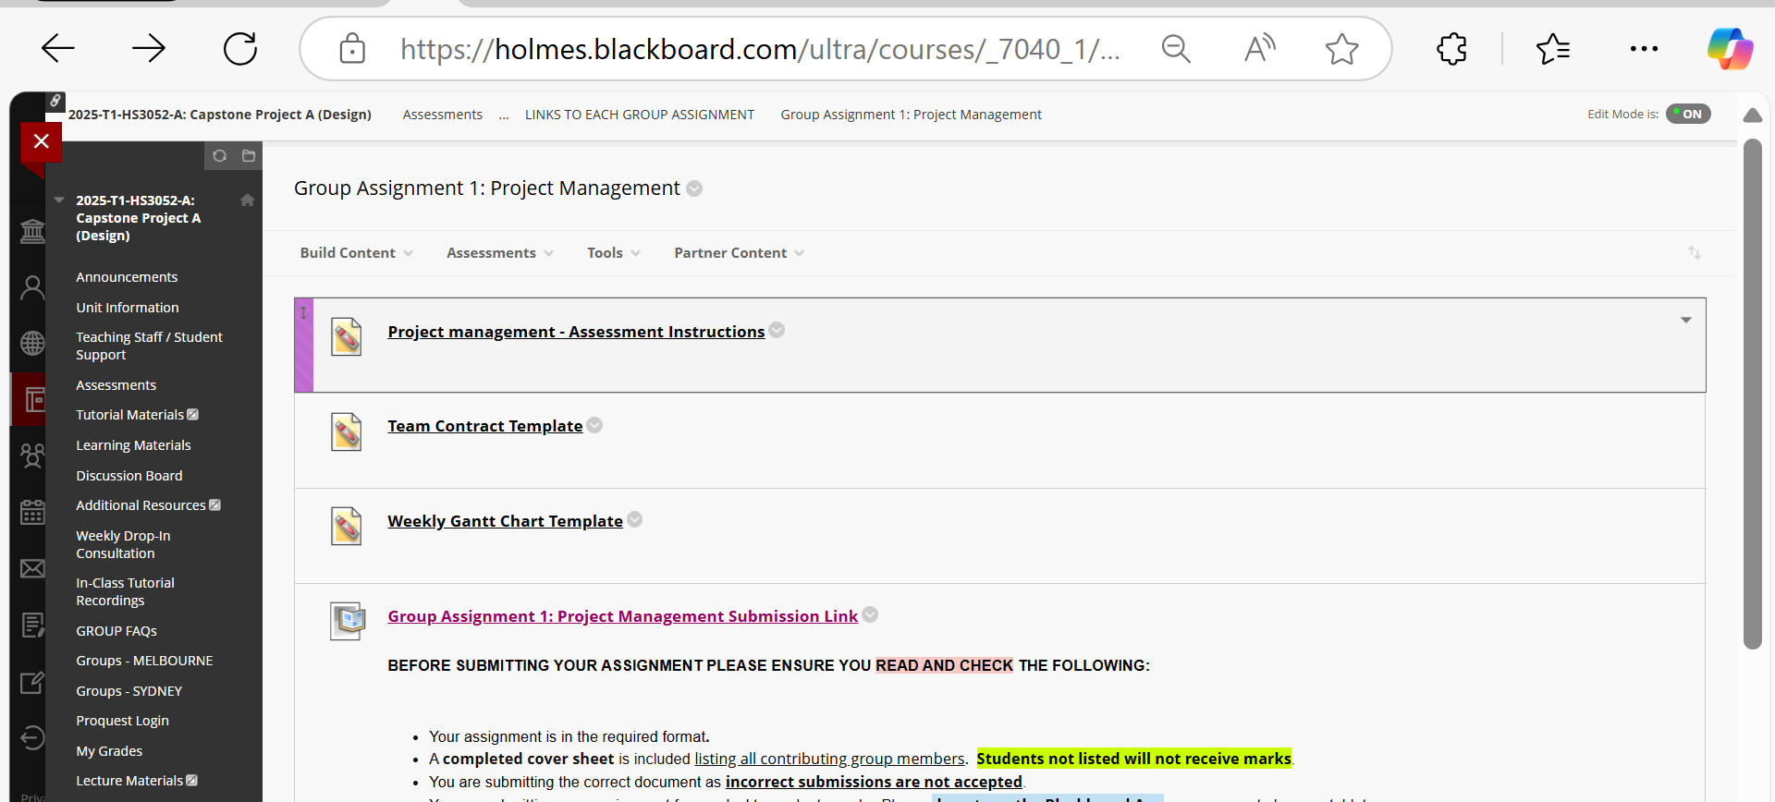
Preparation for Group Assignment 1 – Project Management

Slide 21
Preparation for Group Assignment 1 – Project Management
To submit your assignment, please go to:
Assessments >> Group Assignment Information >> Links to each Group Assignment >> Group Assignment 1: Project Management, then use the 'submission link' towards the bottom of the page to submit.

Slide 22
Preparation for Group Assignment 1 – Project Management
What Students Need to Submit:
A single written report (1000–1500 words, Word document) containing all the following components:
Project Scope Statement
Project Charter
Communication Plan (Matrix format)
Team Contract
Work Breakdown Structure (WBS)
Gantt Chart

Slide 23
Preparation for Group Assignment 1 – Project Management
Additional Documents (within the report or appendices):
Meeting agenda and minutes
Individual timesheets
Project plan overview
Visuals for WBS and Gantt

Slide 24
Preparation for Group Assignment 1 – Project Management
Presentation Requirement:
No recording or face-to-face presentation is explicitly required for this assessment.
However, students should be prepared to show and discuss their project plan and Gantt chart if asked during supervision or future tutorials.
It is good practice to store files in a collaborative tool (like Google Docs or OneDrive) and invite the project supervisor for progress monitoring.

Slide 25
Preparation for Group Assignment 1 – Project Management
What to Do (Best Practices):
Assign clear roles within the group, including a Project Manager who will liaise with the supervisor.
Use a shared collaborative tool (e.g., Google Docs, Trello, or OneDrive) to manage documents and share access with the lecturer.
Follow the Holmes formatting rules:
Font: Calibri, 11pt
File: MS Word
Margins: 2 cm on all sides
Include a cover page with student IDs
File name: HS3052-StudentID
Submit on time via Blackboard and include the Assessment Cover Page.
Use Holmes Harvard referencing for any external sources.

Slide 26
Preparation for Group Assignment 1 – Project Management
X What to Avoid:
Do not submit unrelated or unsupported file types (e.g., .zip or .ppt).
Do not submit without reviewing the document version and names.
Avoid late submissions (penalties apply).
Do not plagiarize or share content between groups—each group’s project must be unique.
Avoid solo group work, as there is a -20% penalty unless formally approved.

Slide 27
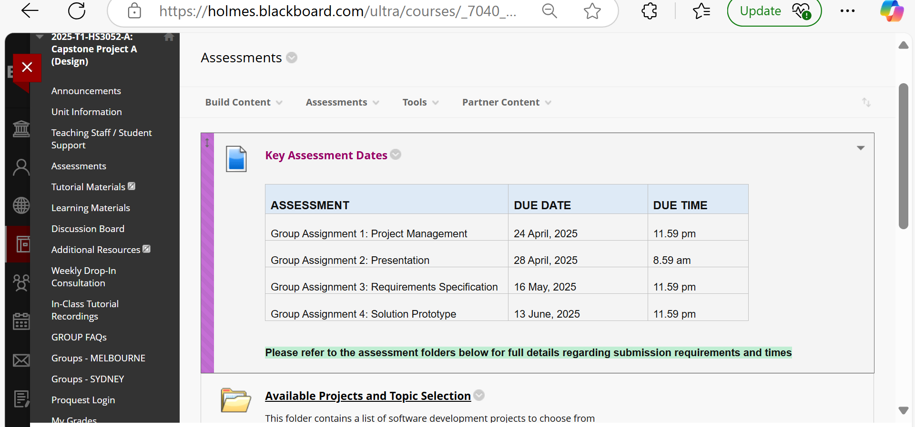
Group Assignments - Due Dates

Slide 28
HTML Forms
HTML/CSS/Java Script/PHP Examples
Forms provide the user with an alternative way to interact with a web server.
Forms provide rich mechanisms like:
Text input
Password input
Options Lists
Radio and check boxes

Slide 29
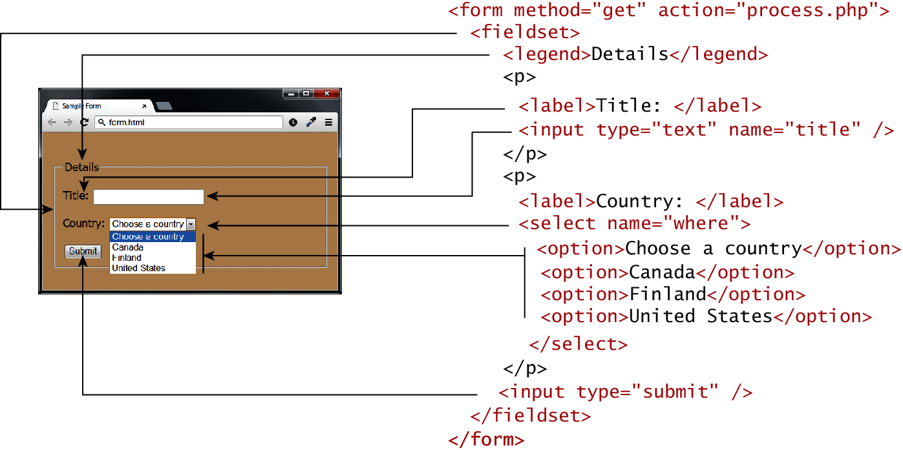
Form Structure

Slide 30
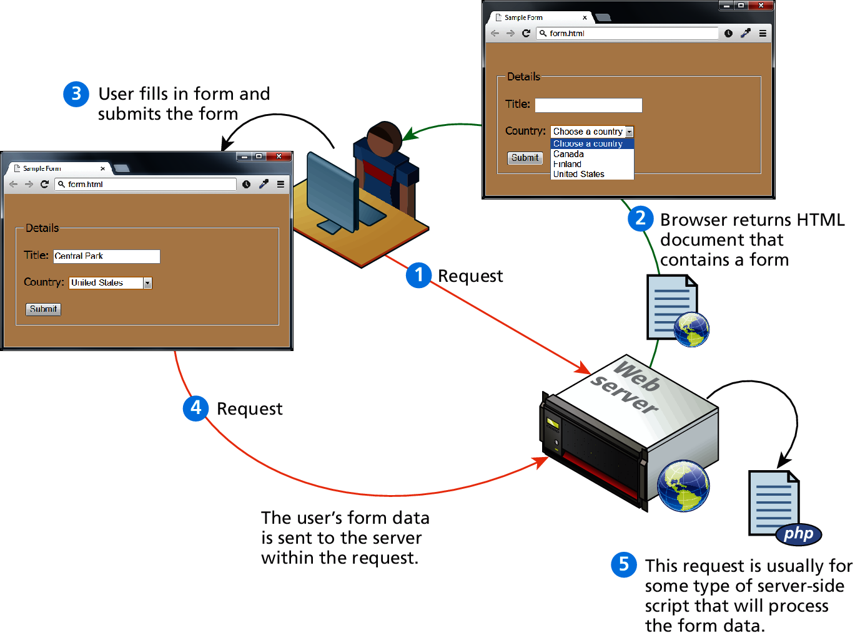
How forms interact with servers

Slide 31
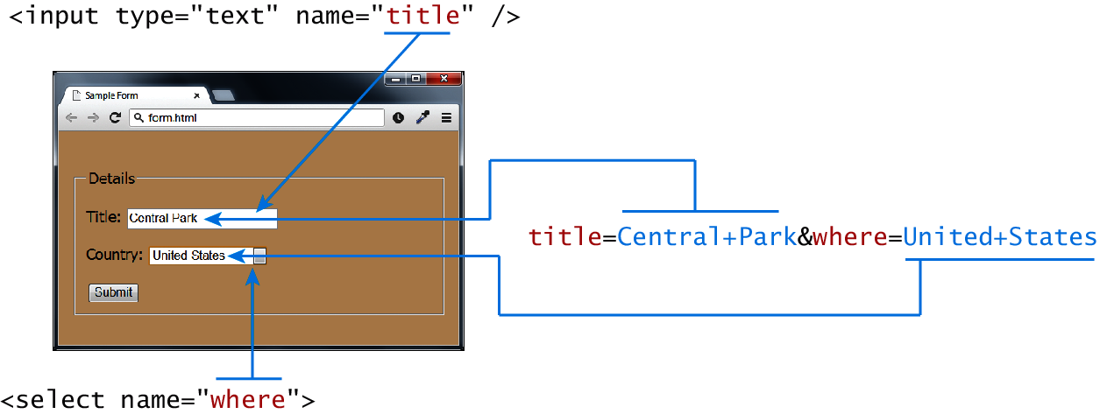
Query Strings

Slide 32
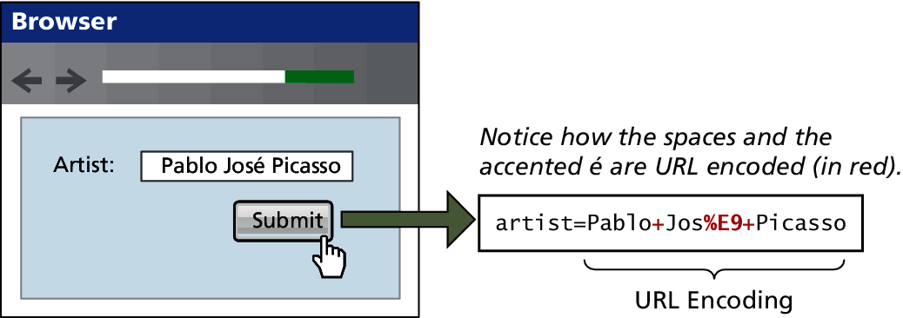
URL encoding

Slide 33
<form> element
Two essential features of any form, namely the action and the method attributes.
The action attribute specifies the URL of the server-side resource that will process the form data
The method attribute specifies how the query string data will be transmitted from the browser to the server.
GET
POST

Slide 34
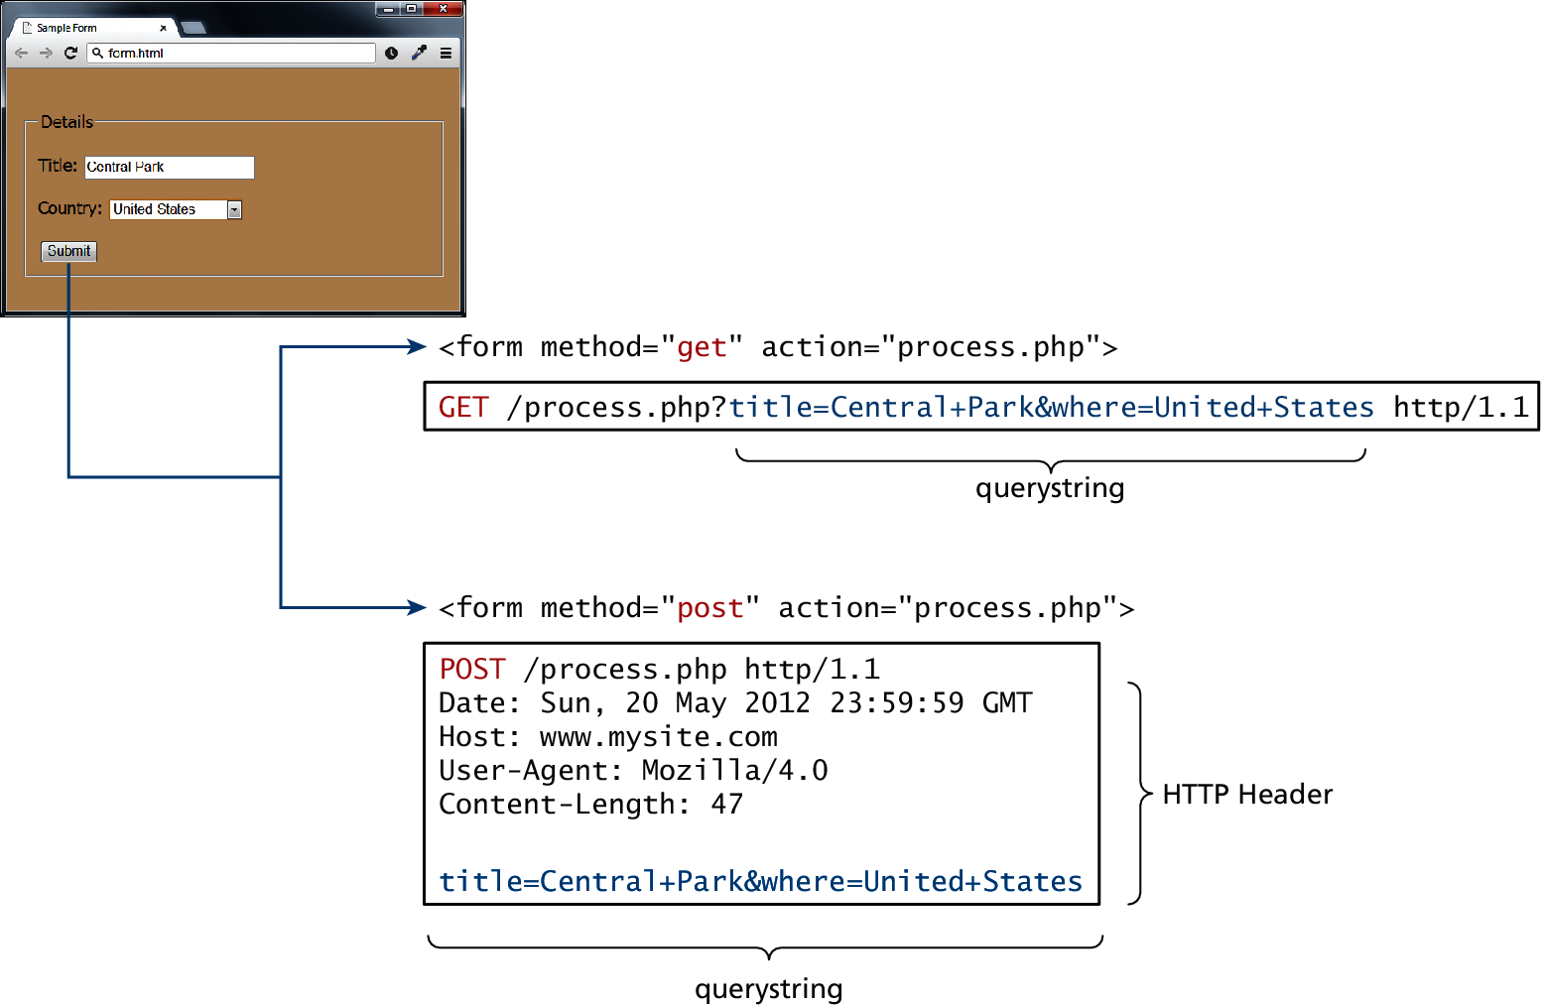
GET vs POST

Slide 35
GET vs POST
GET
Data can be clearly seen in the address bar.
Data remains in browser history and cache.
Data can be bookmarked
Limit on the number of characters in the form data returned.
POST
Data can contain binary data.
Data is hidden from user.
Submitted data is not stored in cache, history, or bookmarks.

Slide 36
Form-Related HTML Elements
Type | Description
<button> | Defines a clickable button.
<datalist> | An HTML5 element form defines lists to be used with other form elements.
<fieldset> | Groups related elements in a form together.
<form> | Defines the form container.
<input> | Defines an input field. HTML5 defines over 20 different types of input.
<label> | Defines a label for a form input element.
<legend> | Defines the label for a fieldset group.
<option> | Defines an option in a multi-item list.
<optgroup> | Defines a group of related options in a multi-item list.
<select> | Defines a multi-item list.
<textarea> | Defines a multiline text entry box.

Slide 37
Text Input Controls
Type | Description
text | Creates a single line text entry box. <input type="text" name="title" />
textarea | Creates a multiline text entry box. <textarea rows="3" ... />
password | Creates a single line text entry box for a password <input type="password" ... />
search | Creates a single-line text entry box suitable for a search string. This is an HTML5 element. <input type="search" … />
email | Creates a single-line text entry box suitable for entering an email address. This is an HTML5 element. <input type="email" … />
tel | Creates a single-line text entry box suitable for entering a telephone. This is an HTML5 element. <input type="tel" … />
url | Creates a single-line text entry box suitable for entering a URL. This is an HTML5 element. <input type="url" … />

Slide 38
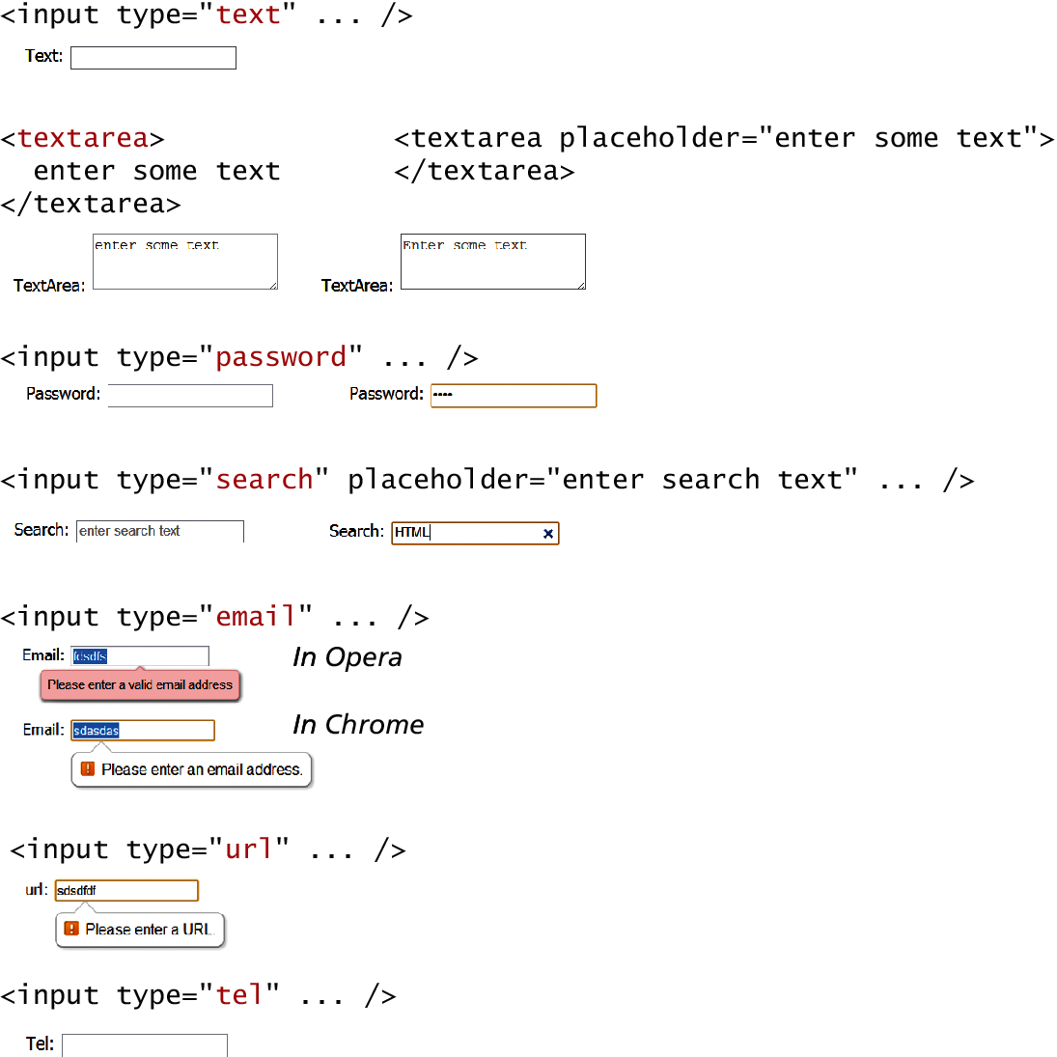
Text Input Controls

Slide 39
Text Input Controls

Slide 40
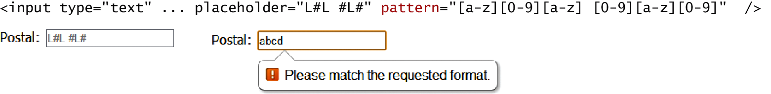
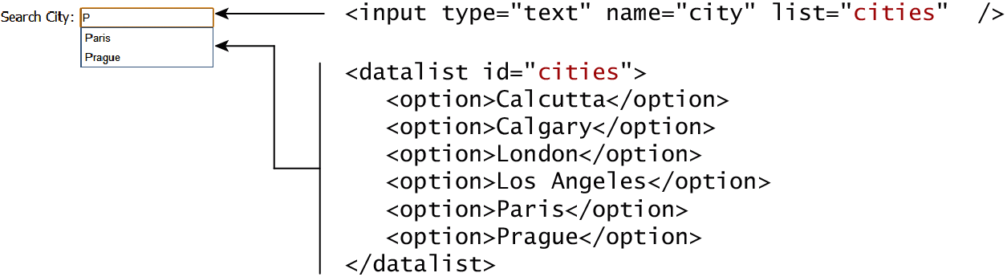
HTML5 advanced controls
Pattern attribute
datalist

Slide 41
Select Lists
<select> element is used to create a multiline box for selecting one or more items
The options are defined using the <option> element
can be hidden in a dropdown or multiple rows of the list can be visible
Option items can be grouped together via the <optgroup> element.

Slide 42
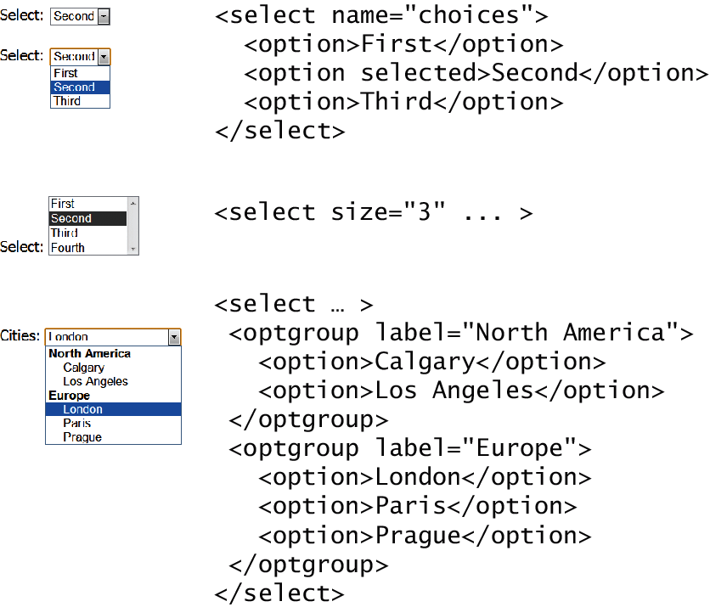
Select Lists

Slide 43
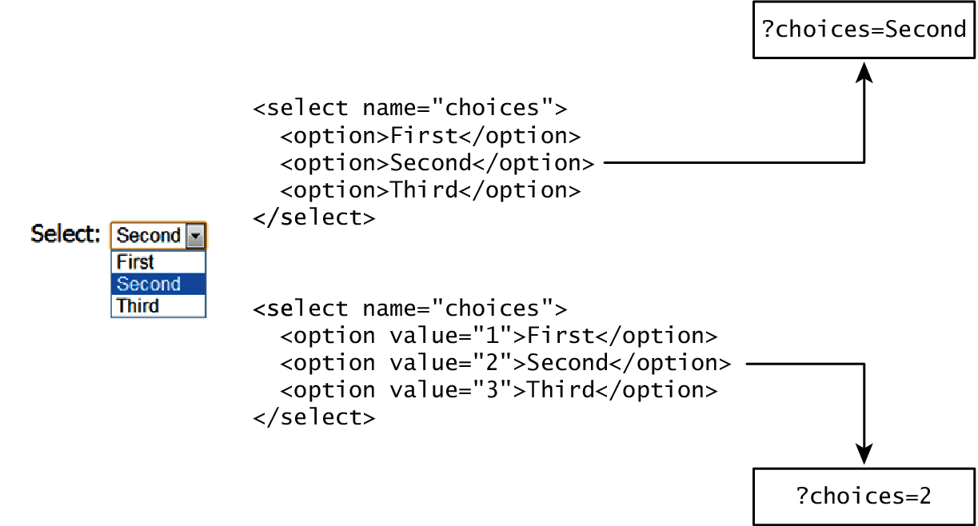
Which Value to send
The value attribute of the <option> element is used to specify what value will be sent back to the server.
The value attribute is optional; if it is not specified, then the text within the container is sent instead

Slide 44
Radio Buttons
Radio buttons are useful when you want the user to select a single item from a small list of choices and you want all the choices to be visible
radio buttons are added via the <input type="radio"> element
The buttons are mutually exclusive (i.e., only one can be chosen) by sharing the same name attribute
The checked attribute is used to indicate the default choice
the value attribute works in the same manner as with the <option> element

Slide 45
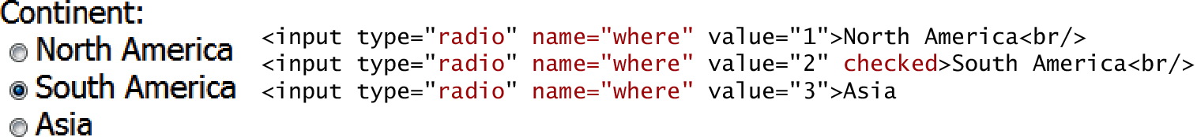
Radio Buttons

Slide 46
Checkboxes
Checkboxes are used for getting yes/no or on/off responses from the user.
checkboxes are added via the <input type="checkbox”> Element
You can also group checkboxes together by having them share the same name attribute
Each checked checkbox will have its value sent to the server
Like with radio buttons, the checked attribute can be used to set the default value of a checkbox

Slide 47
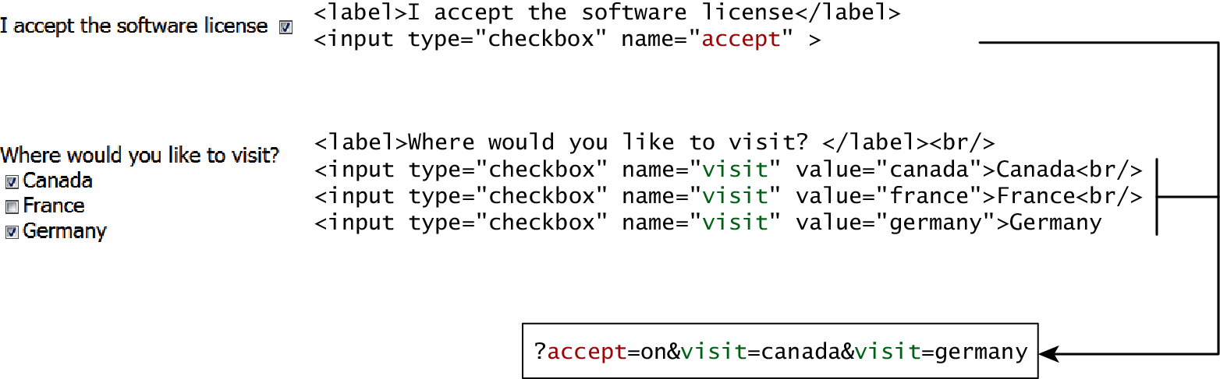
Checkboxes

Slide 48
Button Controls
Type | Description
<input type="submit"> | Creates a button that submits the form data to the server.
<input type="reset"> | Creates a button that clears any of the user’s already entered form data.
<input type="button"> | Creates a custom button. This button may require Javascript for it to actually perform any action.
<input type="image"> | Creates a custom submit button that uses an image for its display.
<button> | Creates a custom button. The <button> element differs from <input type="button"> in that you can completely customize what appears in the button; using it, you can, for instance, include both images and text, or skip server-side processing entirely by using hyperlinks. You can turn the button into a submit button by using the type="submit" attribute.

Slide 49
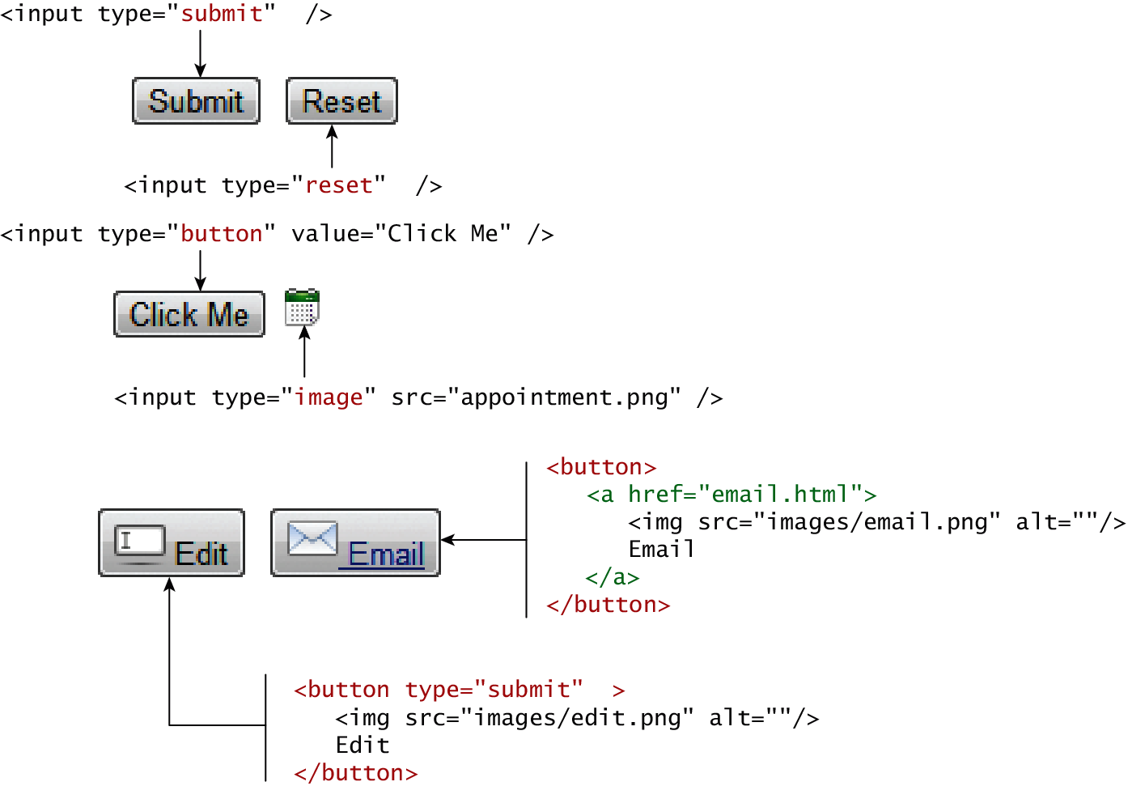
Button Controls

Slide 50
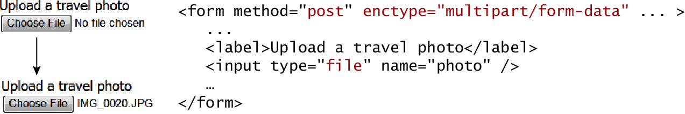
Specialized Controls
<input type=hidden>
<input type=file>

Slide 51
Number and Range
Typically input values need be validated. Although server side validation is required, optional client side pre-validation is good practice.
The number and range controls Added in HTML5 provide a way to input numeric values that eliminates the need for JavaScript numeric validation!!!

Slide 52
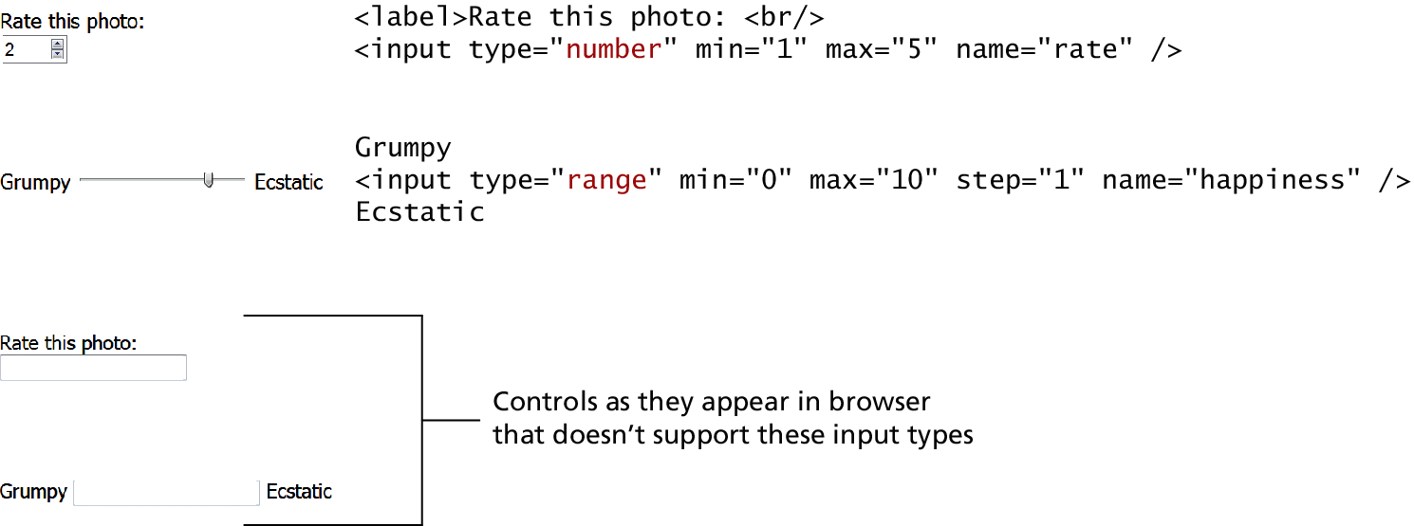
Number and Range

Slide 53
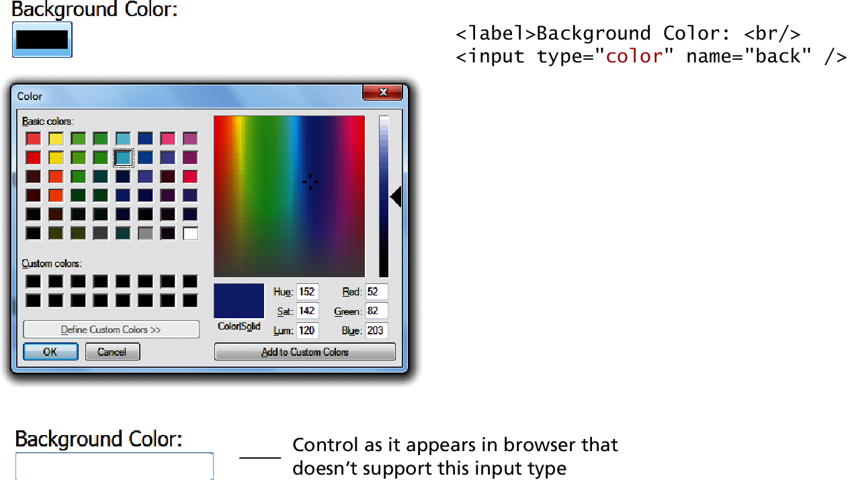
Color

Slide 54
Date and Time Controls
Dates and times often need validation when gathering this information from a regular text input control.
From a user’s perspective, entering dates can be tricky as well: you probably have wondered at some point in time when entering a date into a web form, what format to enter it in, whether the day comes before the month, whether the month should be entered as an abbreviation or a number, and so on.

Slide 55
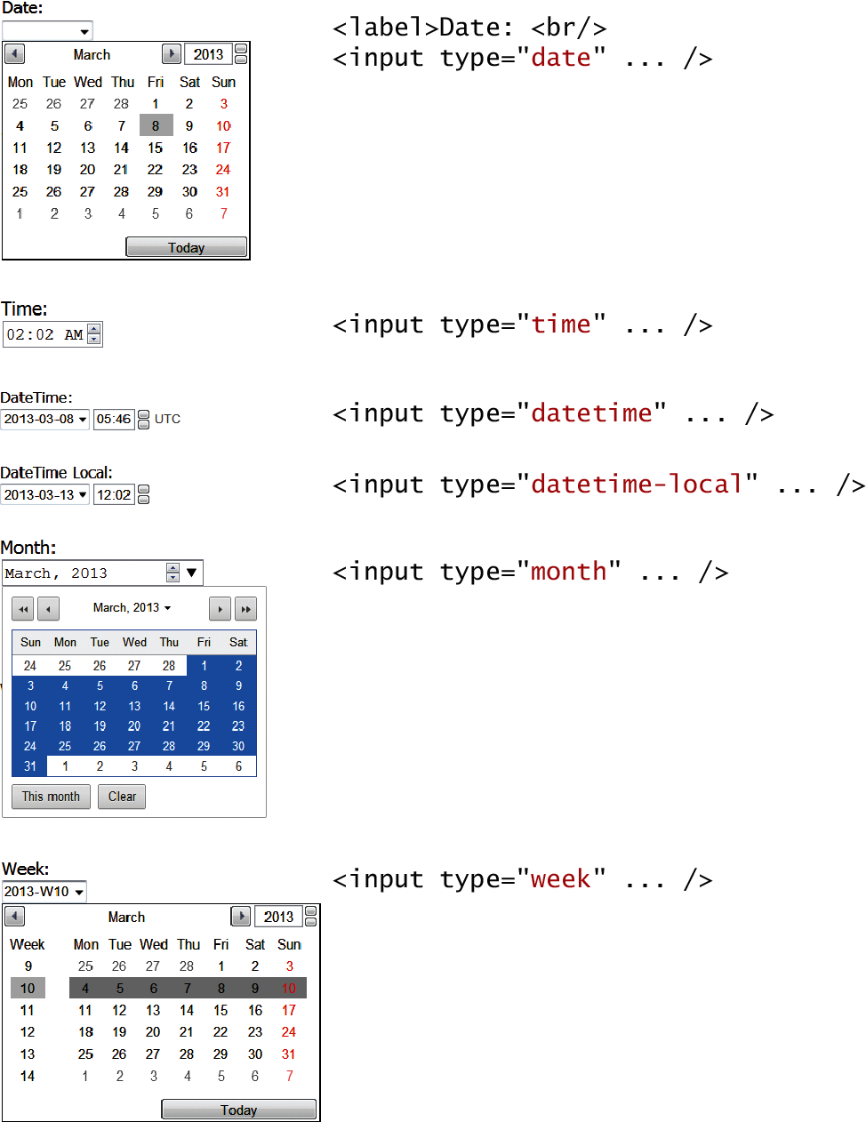
HTML5 Date and Time Controls

Slide 56
HTML5 Date and Time Controls

Slide 57
Open-Ended Question
How can multimedia elements enhance the user experience on a website?
Multimedia elements like images, videos, and audio can make a website more engaging and informative. For example, a Brisbane tourism website might embed videos of popular tourist attractions, providing visitors with a more immersive experience.

Slide 58
Example
Suppose you're designing a website for a Canberra-based educational institution. Embedding instructional videos and audio recordings can help students understand complex topics more effectively.

Slide 59
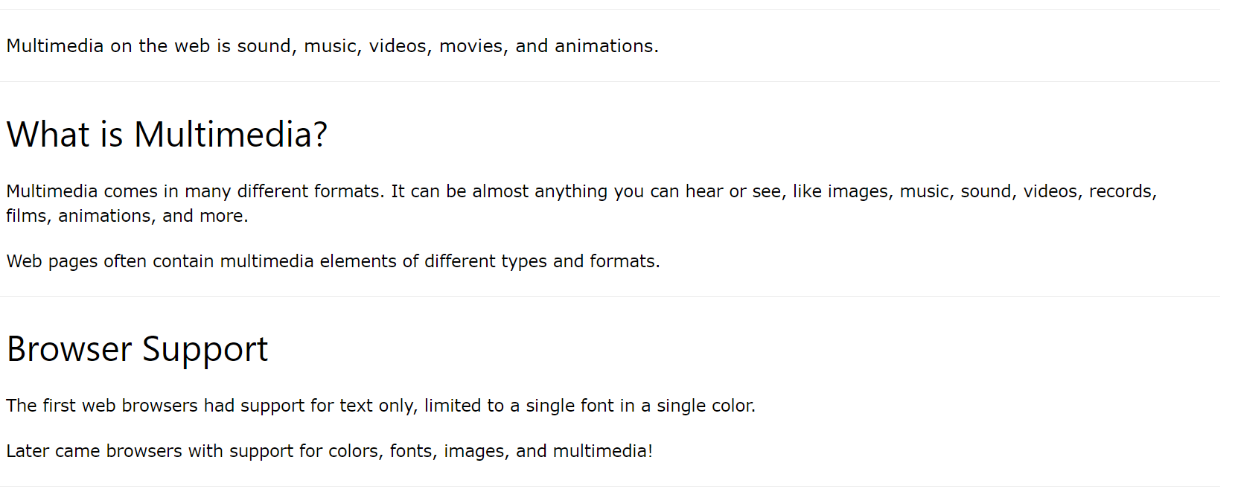
MultiMedia

Slide 60
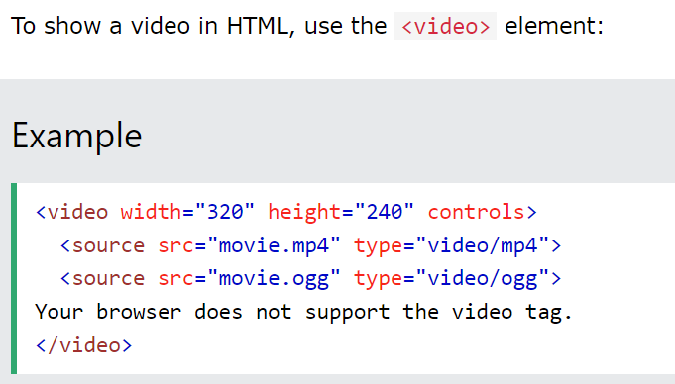
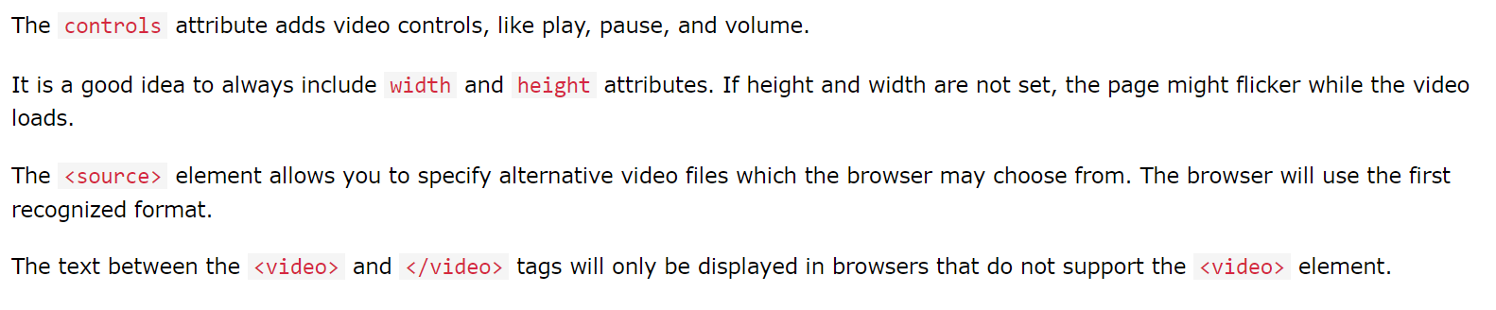
HTML Video

Slide 61
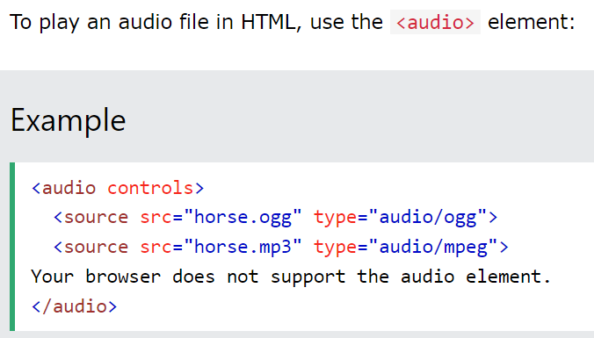
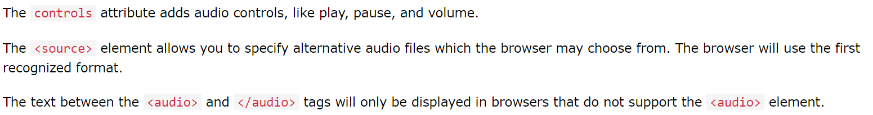
HTML Audio

Slide 62
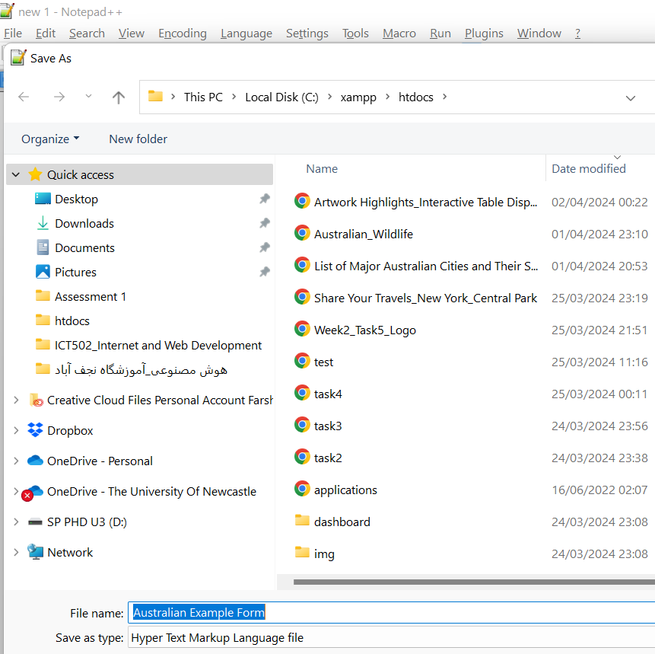
Australian Example Form
Write in Notepadd ++
Australian Example Form
Save in C:\\xampp\hotdocs\
This example includes a 'submit' button, a group of radio buttons, and a select list, which could represent Australian states or cities.

Slide 63
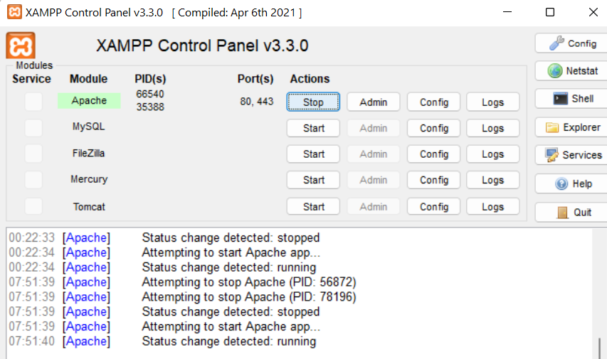
Australian Example Form

Slide 64
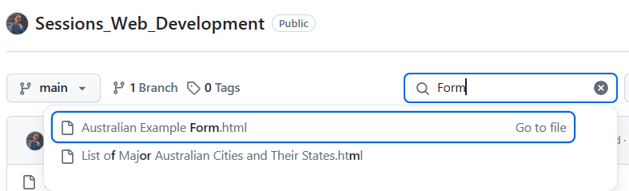
Australian Example Form
https://github.com/FarshidKeivanian/Sessions_Web_Development

Slide 65
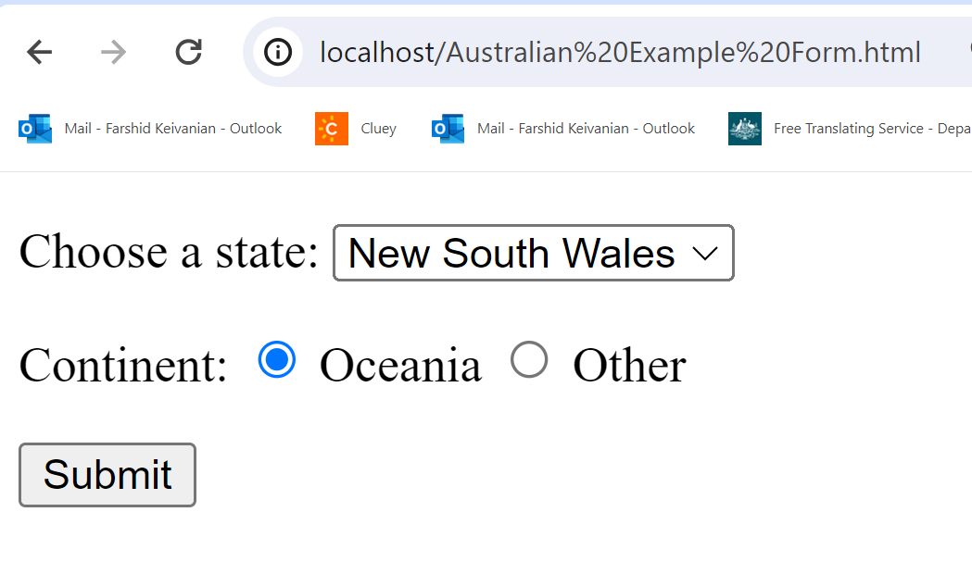
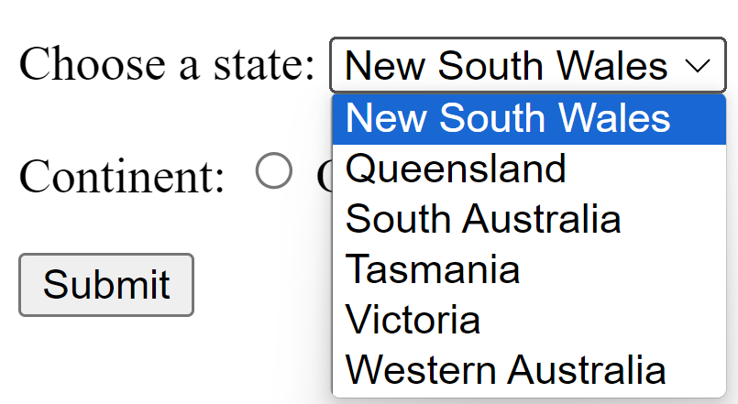
Australian Example Form
http://localhost/Australian Example Form.html

Slide 66
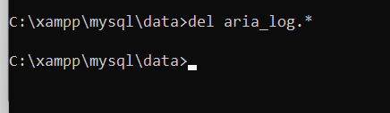
XAMPP Fix Guide – MySQL Error Solution (Simple Steps)
Delete Aria Log Files
Still in the same folder (C:\xampp\mysql\data), run:
del aria_log.*

Slide 67
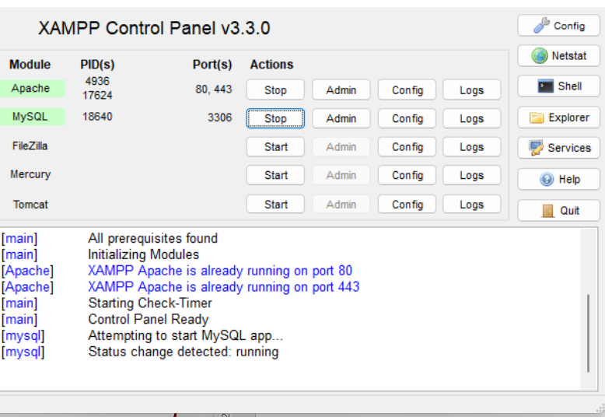
XAMPP Fix Guide – MySQL Error Solution (Simple Steps)
Close XAMPP completely if it's already running.
Right-click the XAMPP Control Panel icon.
Click "Run as administrator".
Once it opens, click Start next to MySQL.
Modules MySQL and Apache are green!

Slide 68
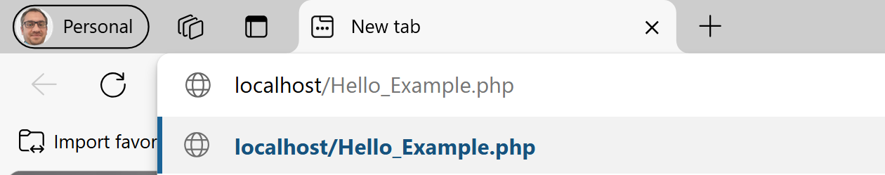
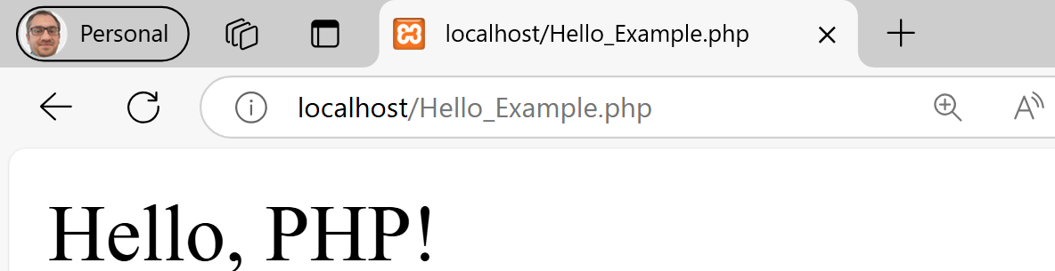
Run Hello_Example.php on Local Host

Slide 69
PHP Form Handling with MySQL (Frontend + Backend)
How can I create a complete HTML form and use PHP to securely store the submitted data in a MySQL database?

Slide 70
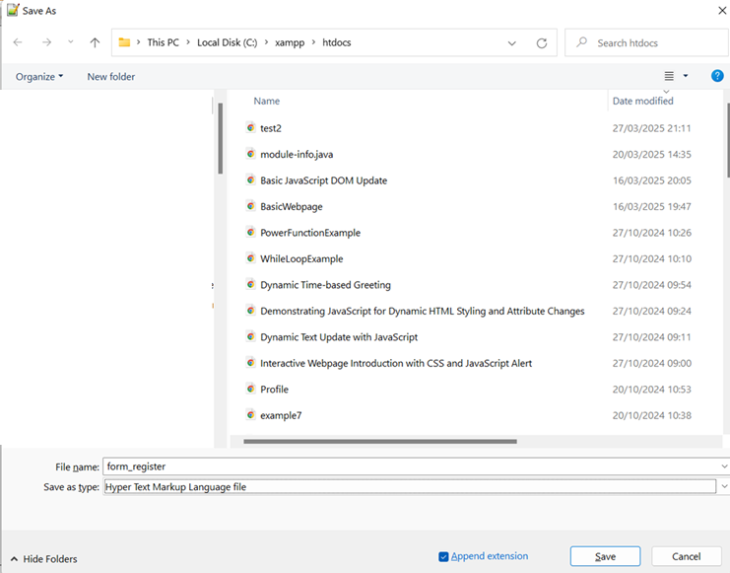
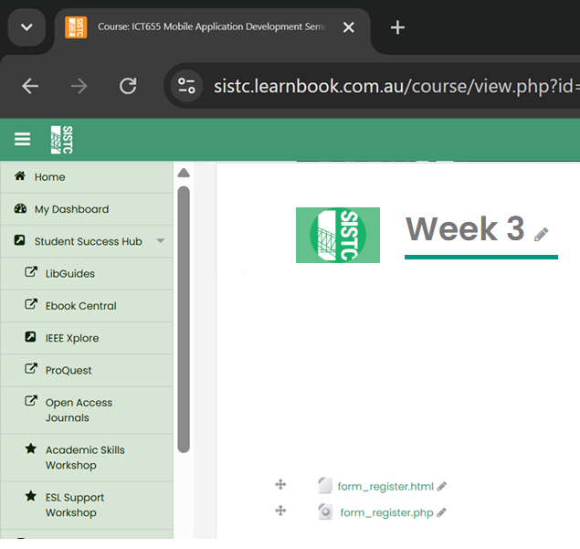
PHP Form Handling with MySQL (Frontend + Backend)
Frontend (form_register.html):
Available on Moodle
Download from Moodle and Save it on C:\xampp\htdocs

Slide 71
PHP Form Handling with MySQL (Frontend + Backend)
<form action="register.php" method="post">
This line starts a form.
action="register.php" tells the browser where to send the form data when the user clicks Submit.
method="post" means the data will be sent securely in the HTTP request body (not visible in the URL).

Slide 72
PHP Form Handling with MySQL (Frontend + Backend)
Name: <input type="text" name="name"><br>
Creates a text box where the user types their name.
The name="name" attribute is the key used in PHP to access the value: $_POST['name'].

Slide 73
PHP Form Handling with MySQL (Frontend + Backend)
Student ID: <input type="text" name="student_id"><br>
Text input for the student's ID.
This value is retrieved in PHP using $_POST['student_id'].

Slide 74
PHP Form Handling with MySQL (Frontend + Backend)
Email: <input type="email" name="email"><br>
An input specifically for email addresses.
The browser will validate the format before submission.

Slide 75
PHP Form Handling with MySQL (Frontend + Backend)
Preferred Language:
<select name="language">
<option>PHP</option>
<option>JavaScript</option>
<option>Python</option>
</select><br>
A dropdown menu.
The user selects their favorite language.
PHP reads this value using $_POST['language'].

Slide 76
PHP Form Handling with MySQL (Frontend + Backend)
<input type="submit" value="Register">
</form>
This is the submit button.
When clicked, the form is sent to register.php.

Slide 77
PHP Form Handling with MySQL (Frontend + Backend)
This HTML form collects:
Student name
Student ID
Email
Preferred programming language
The data is sent to register.php using the POST method. On the server side, PHP receives and processes this data (e.g., storing it in MySQL, validating input, etc.).

Slide 78
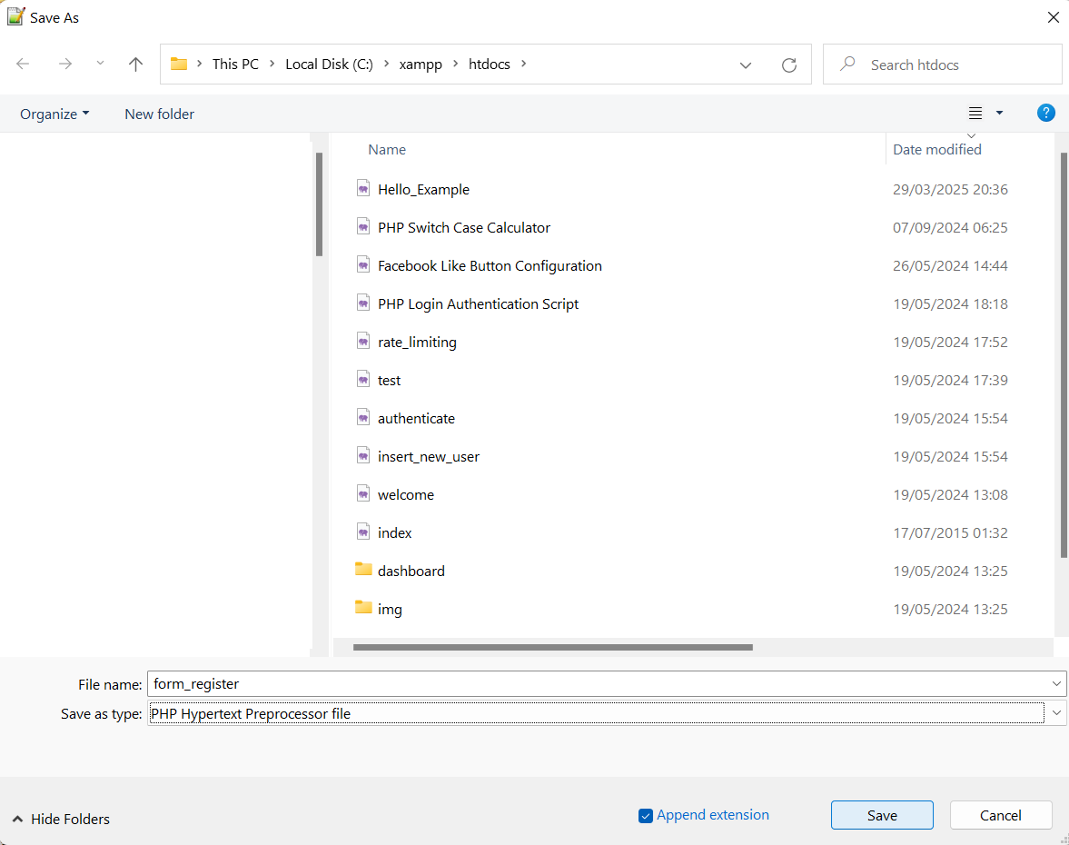
PHP Form Handling with MySQL (Frontend + Backend)
Backend (form_register.php):
Available on Moodle
Download from Moodle and Save it on C:\xampp\htdocs

Slide 79
PHP Form Handling with MySQL (Frontend + Backend)
Explanation of the PHP code from form_register.php:
<?php
$name = $_POST['name'];
$student_id = $_POST['student_id'];
$email = $_POST['email'];
$language = $_POST['language'];
These lines retrieve form data sent via POST method.
Each $_POST['field_name'] gets the user input from the form.

Slide 80
PHP Form Handling with MySQL (Frontend + Backend)
// Basic Validation
if (empty($name) || empty($student_id) || empty($email)) {
echo "Please fill in all fields.";
exit;
}
Basic form validation.
If any required field is empty, it shows a message and stops the script.

Slide 81
PHP Form Handling with MySQL (Frontend + Backend)
// Connect to MySQL
$conn = new mysqli("localhost", "root", "", "ict655");
if ($conn->connect_error) {
die("Connection failed: " . $conn->connect_error);
}
Connects to the MySQL database using mysqli.
localhost, root, and blank password are default XAMPP settings.
If connection fails, it shows the error and stops.

Slide 82
PHP Form Handling with MySQL (Frontend + Backend)
// SQL Injection Protection
$stmt = $conn->prepare("INSERT INTO students (student_id, name, email, language) VALUES (?, ?, ?, ?)");
$stmt->bind_param("ssss", $student_id, $name, $email, $language);
$stmt->execute();
Prepares a secure SQL query to insert data into the students table.
bind_param("ssss", ...) ensures each input is treated as a string to prevent SQL injection.
Executes the statement.

Slide 83
PHP Form Handling with MySQL (Frontend + Backend)
echo "Student $student_id successfully registered!";
?>
Displays a confirmation message after successful insertion.

Slide 84
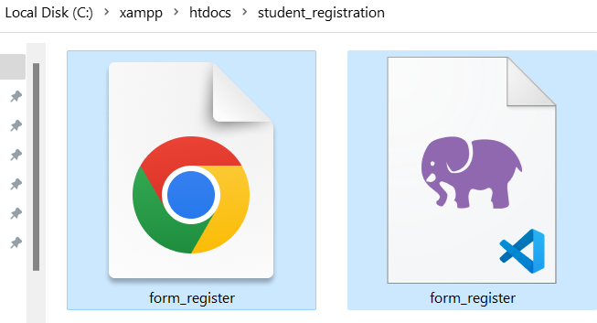
PHP Form Handling with MySQL (Frontend + Backend)
Both form_register.html and form_register.php should be saved in: For example:
C:\xampp\htdocs\student_registration\

Slide 85
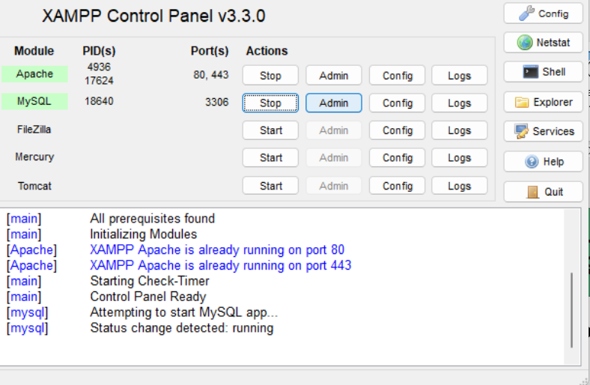
PHP Form Handling with MySQL (Frontend + Backend)
Create the Database
Click on Admin next to MySQL
In phpMyAdmin (access via http://localhost/phpmyadmin):

Slide 86
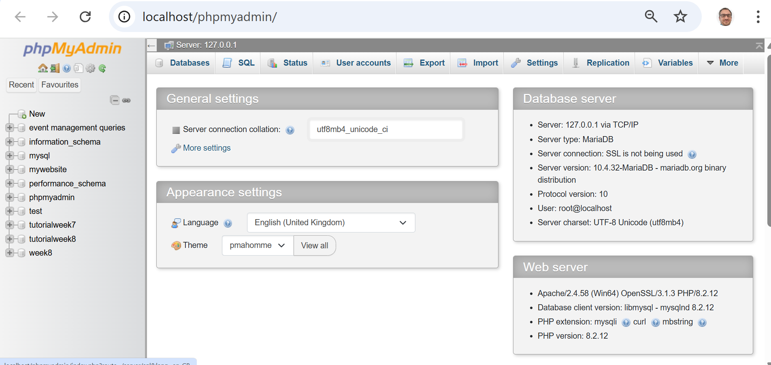
PHP Form Handling with MySQL (Frontend + Backend)
Click on SQL
Run this SQL Code:

Slide 87
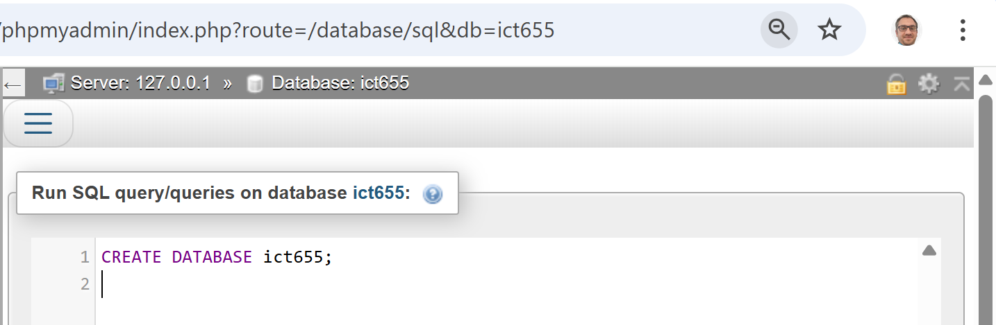
PHP Form Handling with MySQL (Frontend + Backend)
Click on SQL
Run this SQL Code (Click on Go)

Slide 88
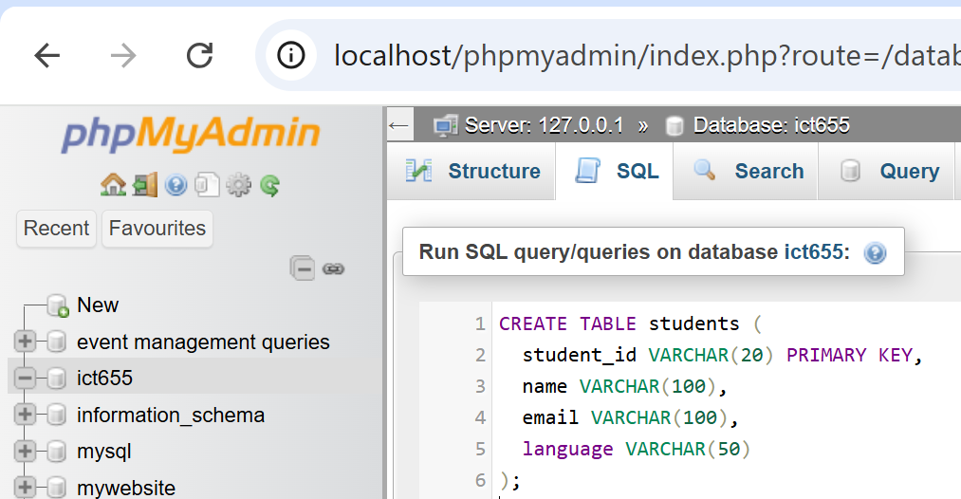
PHP Form Handling with MySQL (Frontend + Backend)
Create the students Table
After selecting ict655 database in phpMyAdmin, go to the SQL tab and paste:
Click on GO
CREATE TABLE students (
student_id VARCHAR(20) PRIMARY KEY,
name VARCHAR(100),
email VARCHAR(100),
language VARCHAR(50)
);

Slide 89
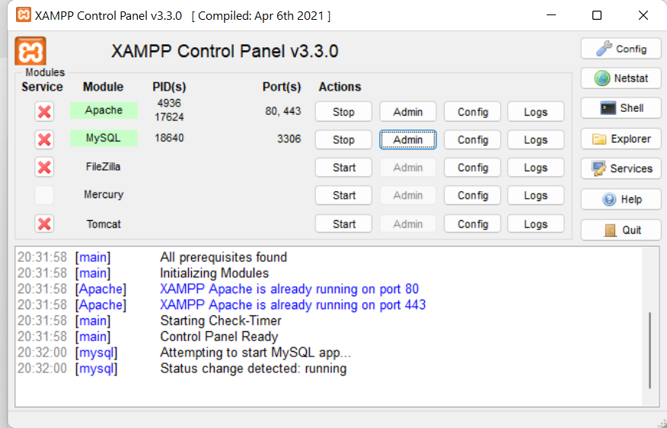
PHP Form Handling with MySQL (Frontend + Backend)
Start Services in XAMPP
Ensure the following are green in the XAMPP control panel:
Apache (for the PHP backend)
MySQL (for the database)

Slide 90
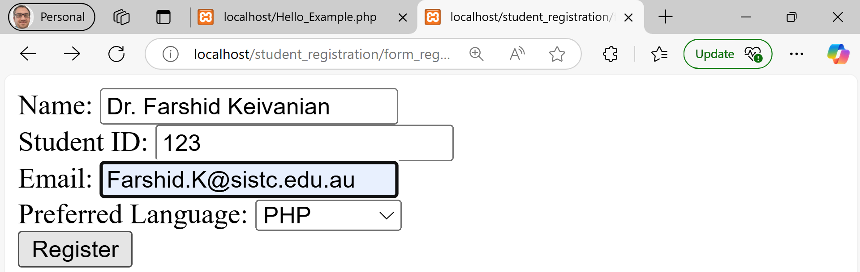
PHP Form Handling with MySQL (Frontend + Backend)
Open your browser and go to:
localhost/student_registration/form_register.html
Enter Sample Input

Slide 91
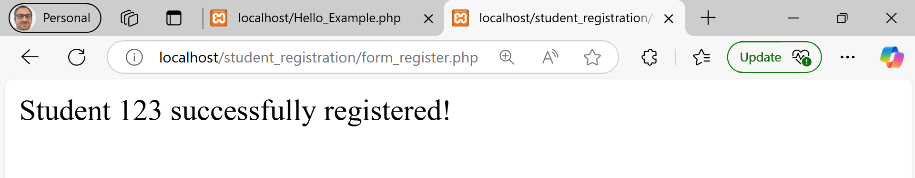
PHP Form Handling with MySQL (Frontend + Backend)
Once you submit, it should insert this exact row into the database table

Slide 92
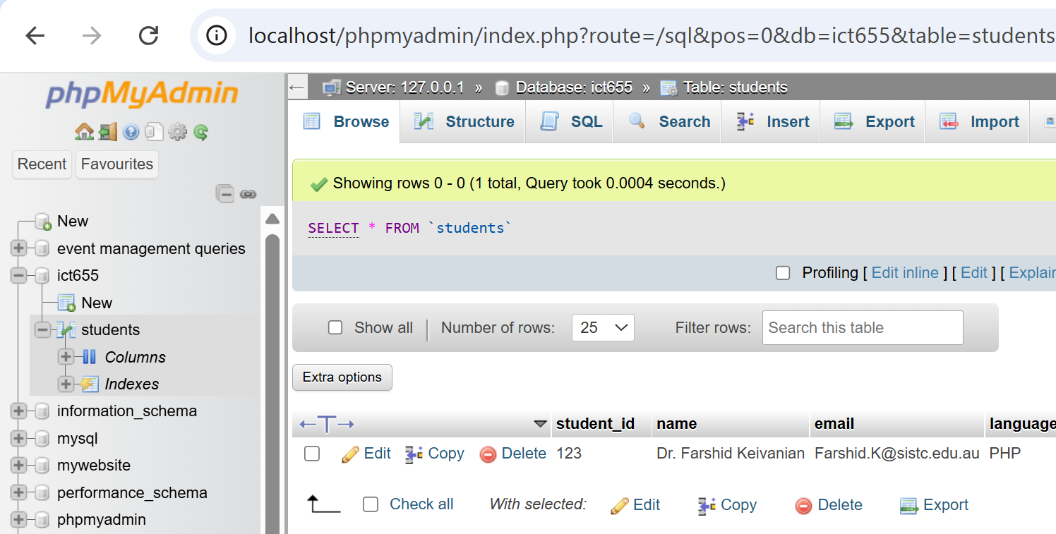
PHP Form Handling with MySQL (Frontend + Backend)
How to See the Change Happened in Your Database
Using phpMyAdmin (GUI Way)
Open your browser and go to: http://localhost/phpmyadmin
From the left panel, click on the ict655 database.
Click on the students table.
Click the Browse tab at the top.
We should now see a row with your inserted data (Student ID 123, name Dr. Farshid Keivanian, etc.)

Slide 93
Best of Luck
Dr Farshid Keivanian
HS3052

